Slide 1
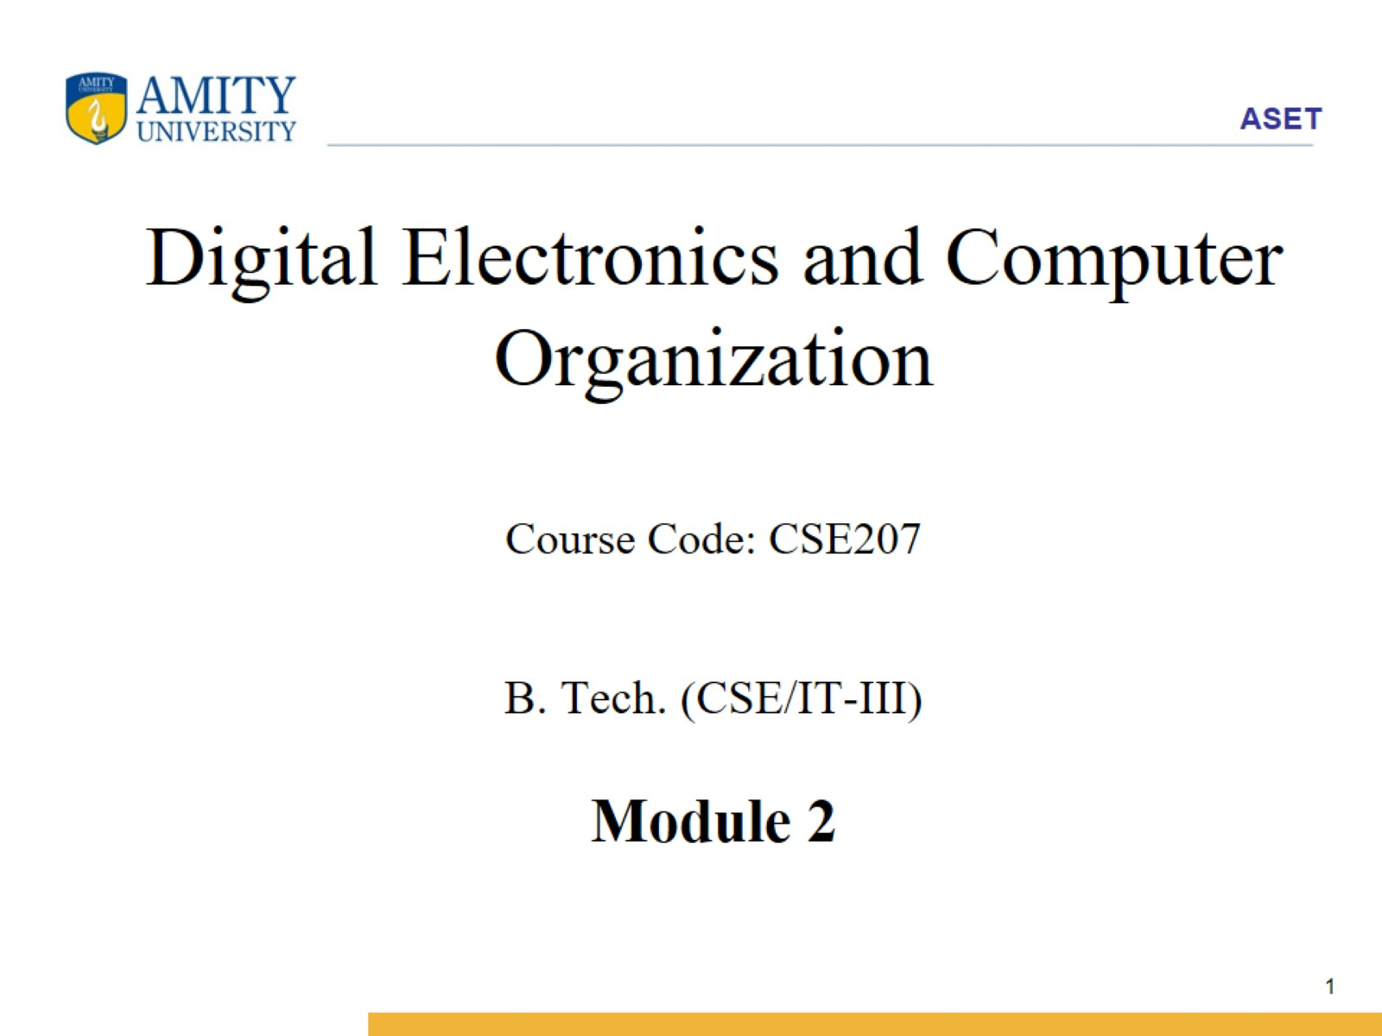
Digital Electronics and Computer Organization Course Code: CSE207 B. Tech. (CSE/IT-III) Module 2

Slide 2
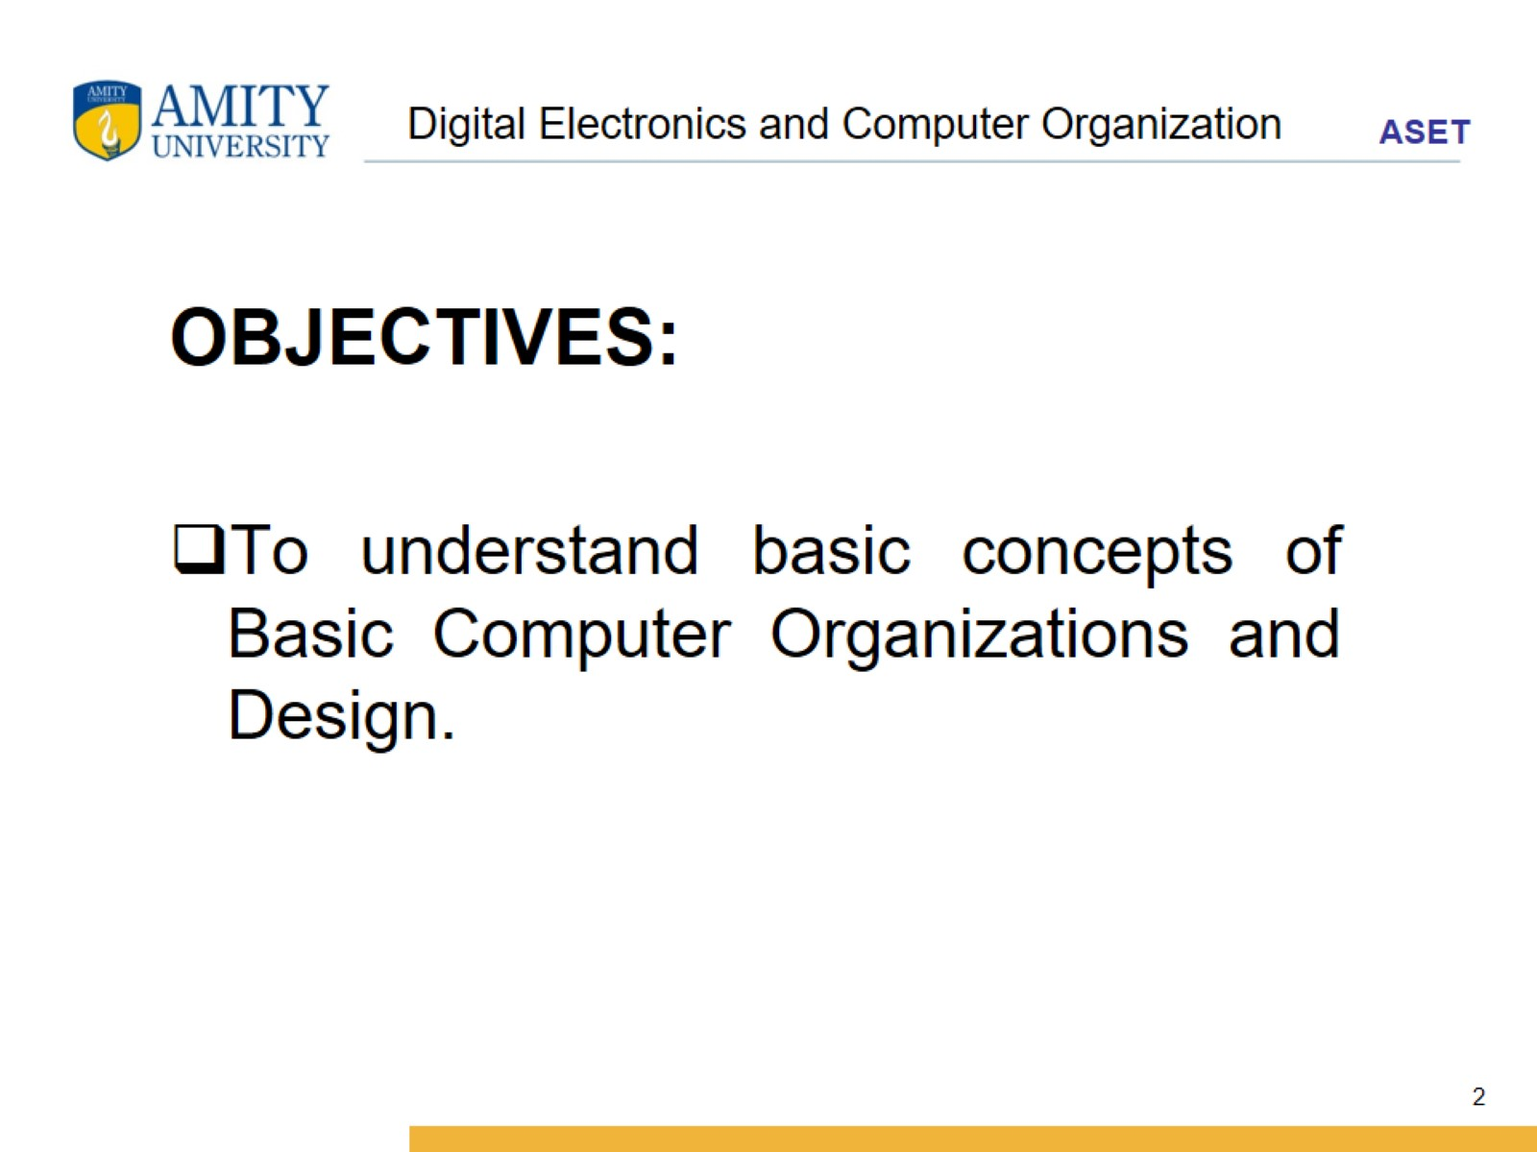
Digital Electronics and Computer Organization

Slide 3
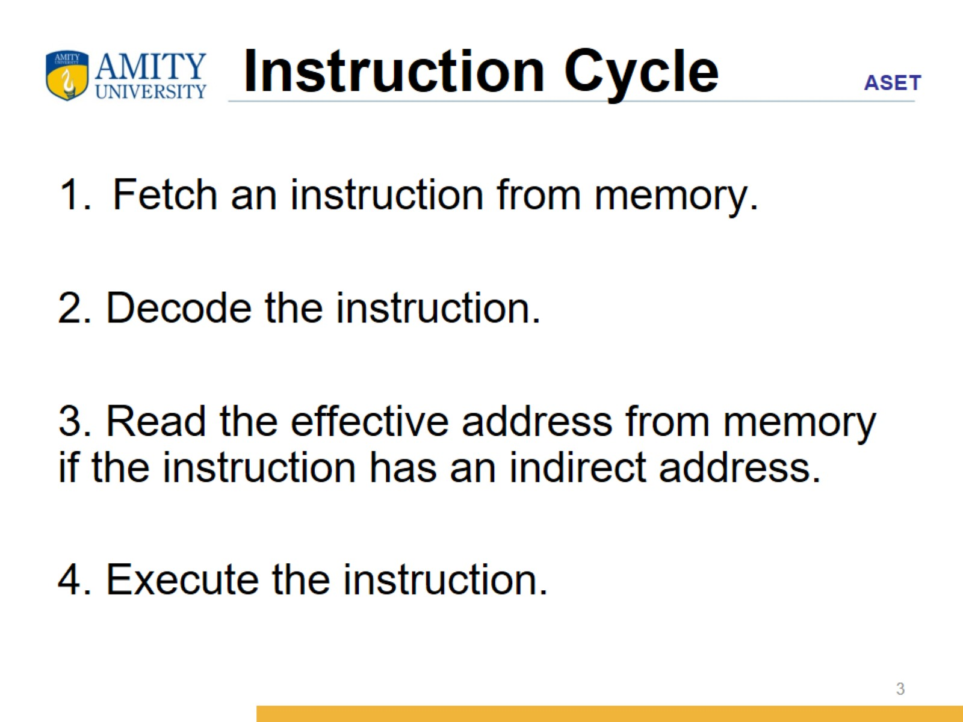
Instruction Cycle

Slide 4
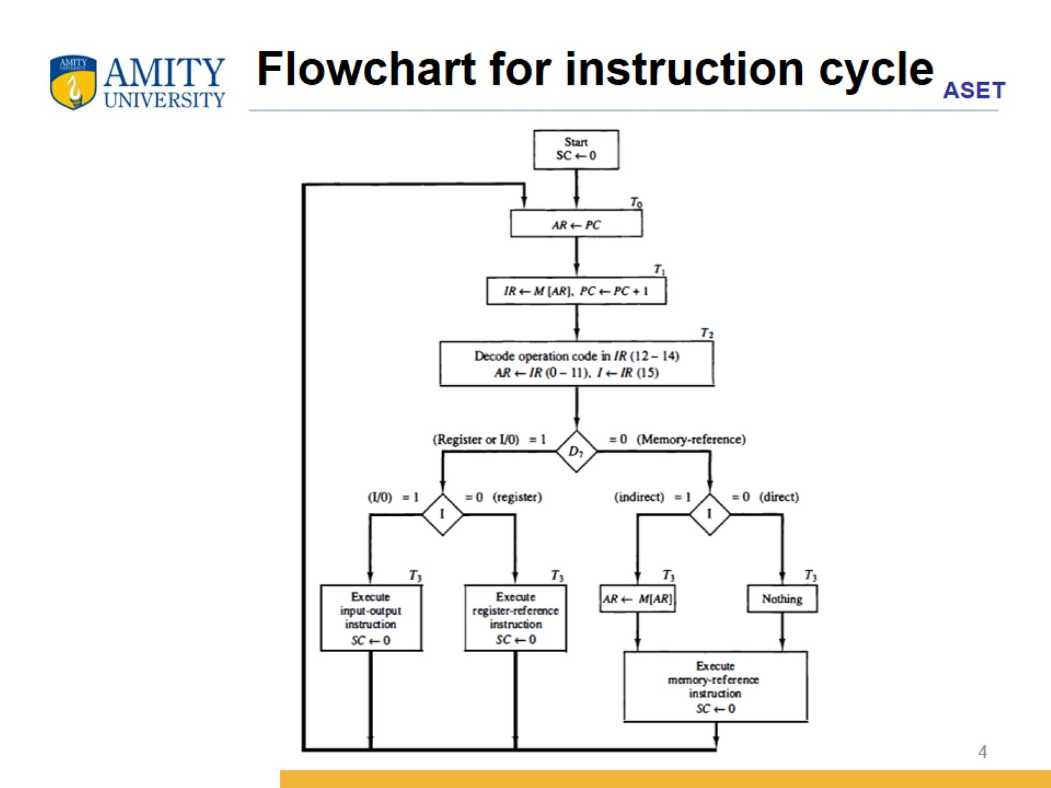
Flowchart for instruction cycle

Slide 5
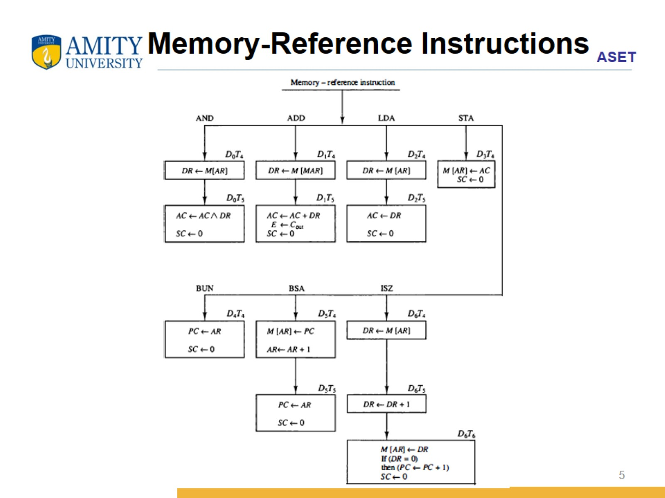
Memory-Reference Instructions

Slide 6
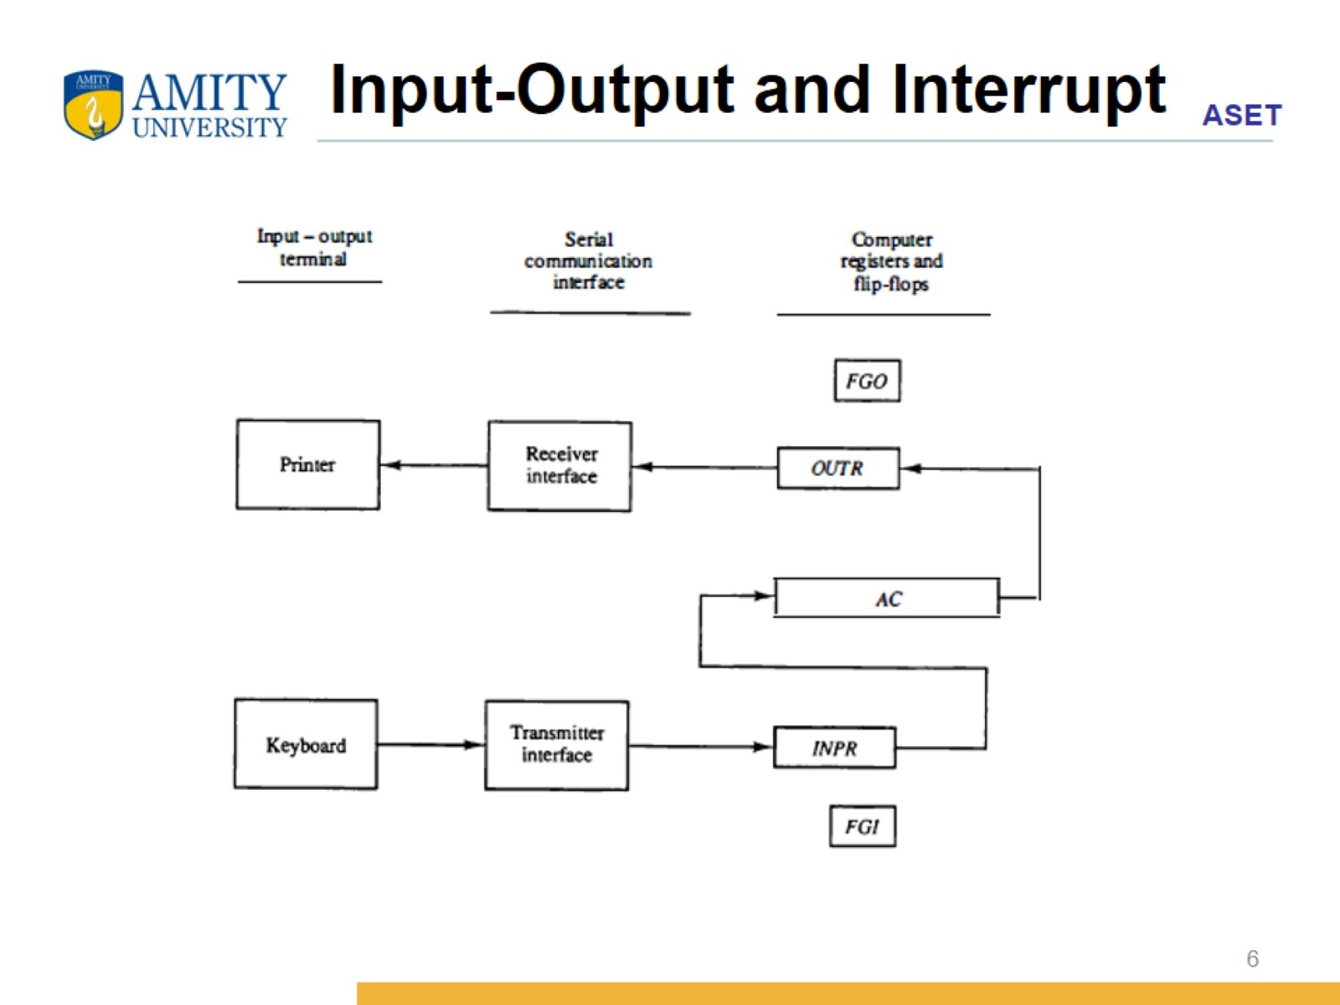
Input-Output and Interrupt

Slide 7
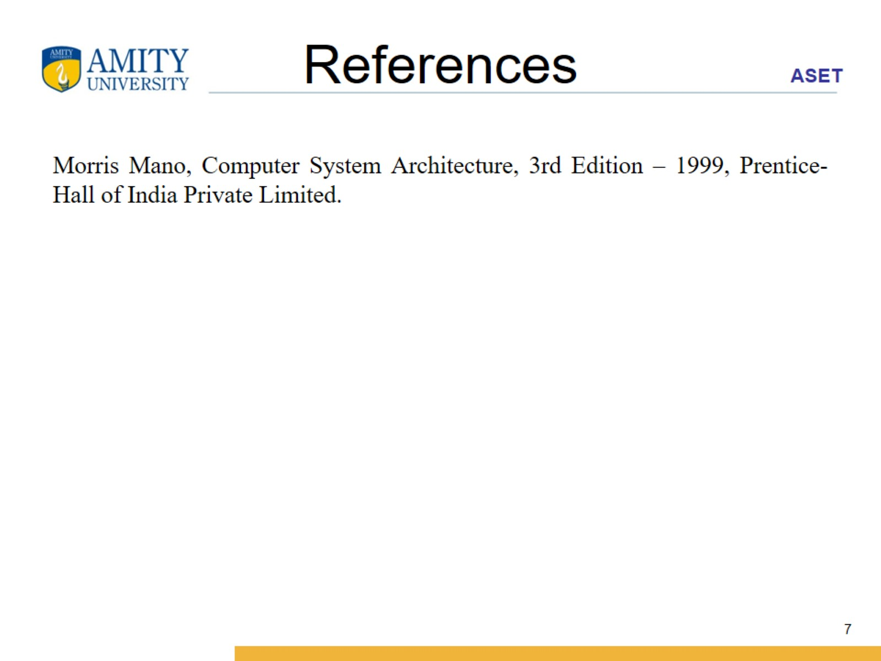
References

